Slide 1
Cleaning Up Coastlines
By Brandon Bennitt and Yashwanth Praveen Pasupuleti

Slide 2
Presentation Outline
Introduction and Purpose
Proposed Solution
Project Timeline
Detailed View of Dataset
Preprocessing
6. Exploratory Data Analysis
7. Modeling and Model Results
8. Model Diagnosis
9. Conclusion and Future Works

Slide 3
Overview
Context
Problem statement
Every year, 8 million metric tons of plastic end up in our oceans.
Over $90 billion is being spent on cleaning up ocean trash, better managing waste, improving water treatment plants, and research to combat this problem.
One of the many ways the amount of trash entering the ocean can be reduced is organizing clean up efforts on beaches and coastlines.
Organizations that help with these efforts are tasked with planning and assigning workers to multiple beaches. Often it is a challenge to know how many workers to assign to a beach.

Slide 4
Our Solution - Main Goal
Thought Process Our Implementation to Solve Problem
There are no/limited organizations that employ people to clean beaches
With limited amount of people willing to volunteer we must maximize labor
If we know how much garbage is on a beach and how large the beach is, we can estimate the amount of labor needed to clean the beach
Use data from previous clean up events to predict how much garbage would be at a future event
Given garbage that will be at each event, we can distribute volunteer labor to maximize our efforts
With labor efforts as efficient as possible, we can help solve the pollution problem more effectively

Slide 5
Our Solution - Sub Goals
Questions How to Answer
What county has the highest garbage to population ratio?
Is there a relationship between the amount of garbage on a beach and the state that the beach is in?
Is the amount of garbage on the shorelines related to the political party that was nominated in the previous presidential election?
In certain states is it more likely to find a higher percentage of plastic in the garbage collected?
Compute average garbage collected per cleanup per county. Divide average garbage by county population. Create visualization
Create visualization to show average garbage per cleanup in each state
Use visualization from question 2 but color each state as political party. For quantitative results, run hypothesis test
Create visualization showing portion of total garbage collected that was plastic
Notes:
Explain during the presentation why we asked these questions and what can be done if we do see certain relationships/patterns come up while answering the questions

Slide 6
Project Overview and Planning

Slide 7
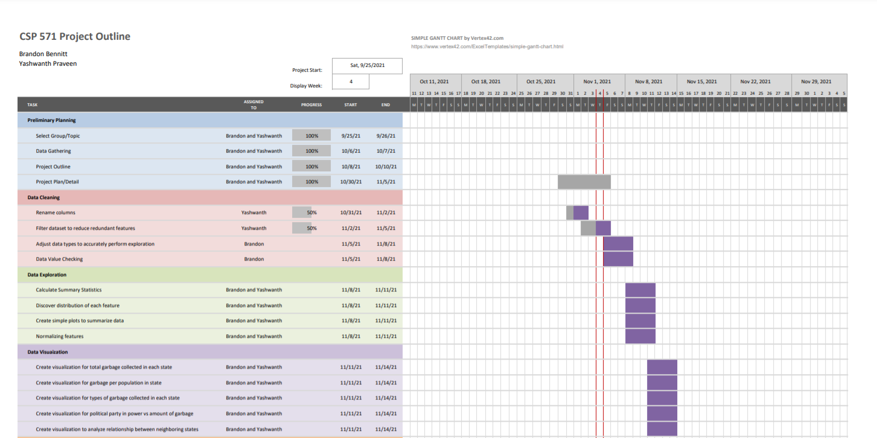
Initial Project Planning
Task Headings
Preliminary Planning
Data Cleaning
Data Exploration
Data Visualization
Data Analysis
Model Building
Model Diagnosis
Final Project Wrap Up
Notes:
In this slide, talk about the process of planning different steps along the way to complete our final goal.
Highlight key areas that we first thought about and how we decided on dates. Had to put together a plan without having much experience of how long each task would take or without knowing in advance what challenges would present themselves along the way.

Slide 8
Challenges/Changes in Project Planning
Challenges Solutions
Data cleaning and exploration took longer than anticipated
Certain features had to be engineered starting with manual data collection
Other projects and deadlines approached quickly
Data did not contain as much explanatory power as we hoped
Rescale our milestone deadlines to ensure sufficient time to clean and explore data
Group effort to split monotonous work in half
Communicate with team members about rescheduling meetings to work together
Discuss what important features we may be missing and how to improve

Slide 9
Dataset Overview

Slide 10
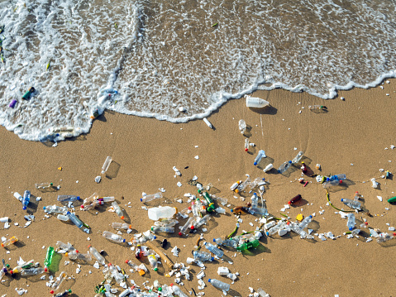
Initial Dataset
Overview
Global plastics dataset from 2015-2018
Approximately 55,000 rows with entries from multiple countries around the world and across the entire US
Only ~2,000 rows were entries from U.S. events
U.S. data would allow for more inferential work

Slide 11
Initial Dataset
Columns
(X,Y) - Specifies the location coordinates
SubCountry_L1_FromSource (State)
SubCountry_L2_FromSource (City)
TotalWidth_m - width of the beach
TotalLength_m - length of the beach
ShorelineName - name of the beach
TotalVolunteers - Number of volunteers that helped with the recorded task
Year - year which the cleanup took place
MonthNum - number between 1-12 to represent the month the cleanup took place
Day - number between 1-31 to record the day of the month the cleanup took place
11. TotalItems_EventRecord - Total number of items that were collected as garbage
12. TotalClassifiedItems_EC2020 - Total number
of items that were classified into a category
13. PCT_PlasticAndFoam - Percent of items
classified as plastic or foam
14. PCT_Glass_Rubber_Lumber_Metal - Percent
of items classified as glass, rubber, lumber, or
metal
15. LAND_TYPE - Type of land. Primary land,
small/large island
16. LAND_RANK - The land type encoded in
numerical values

Slide 12
Manual Data Additions
Most sub-questions required additional data that was not in original dataset
Needed feature for political affiliation
Needed feature for population in each county
Needed minimum wage in each county to predict labor cost required
Researched to find datasets
Found a census dataset containing the population of each county in the U.S. as of 2019
Write code to join column for population
Found dataframe containing 2020 election results for each state
Write code to join column for political affiliation
No dataset for minimum wage per county
Manually research and create csv with county and corresponding minimum wage
Notes:
Talk through the challenges here on the different data Wrangling that we had to do

Slide 13

Data Cleaning and Preprocessing
Cleaning and standardizing column names
Remove columns with N/A
Converting variables to appropriate data types
Filtering data pertaining only to U.S.
Unifying the state and county names
Merge data from different csv files to get required dataframe
Convert required character variables into factor variables
Notes:
Talk through the challenges here on the different data Wrangling that we had to do

Slide 14
Exploratory Data Analysis

Slide 15
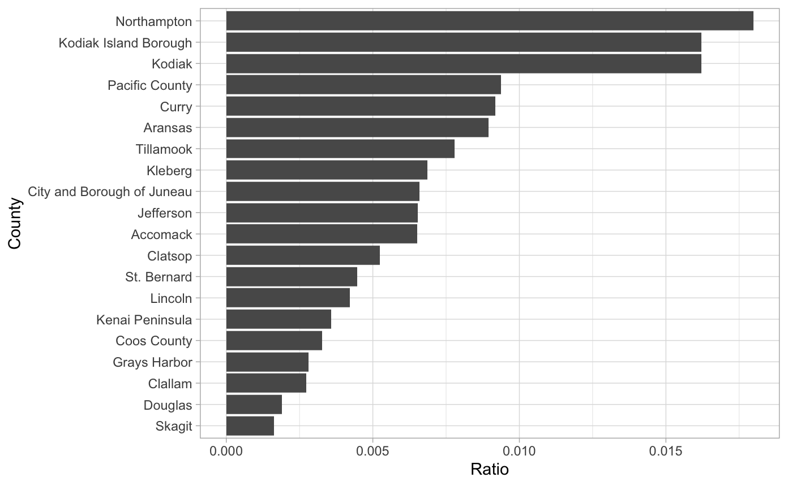
County Population to Garbage Ratio
Notes:
Talk through the challenges here on the different data Wrangling that we had to do

Slide 16
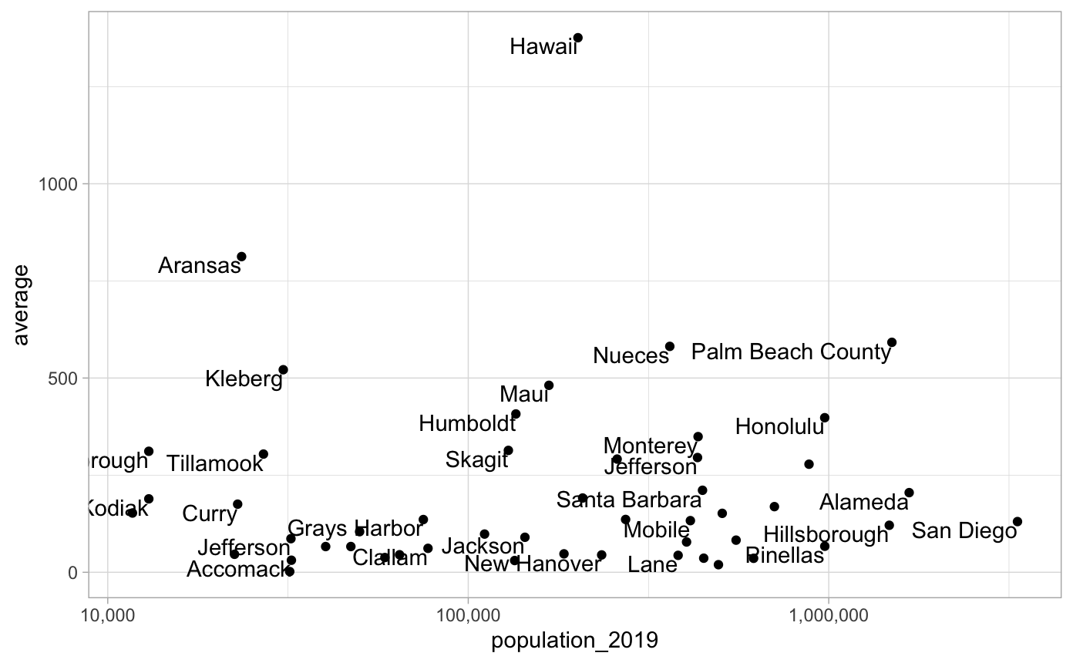
Relation Between County Population and Garbage Collected
Notes:
Relation between county’s population and the garbage found in a beach on that county -> scatter plot to see if we can pick up any type of correlation related to population. For certain county’s, they may not be population dependent, because they may have an influx of people because of vacation spot, such as Hawaii

Slide 17
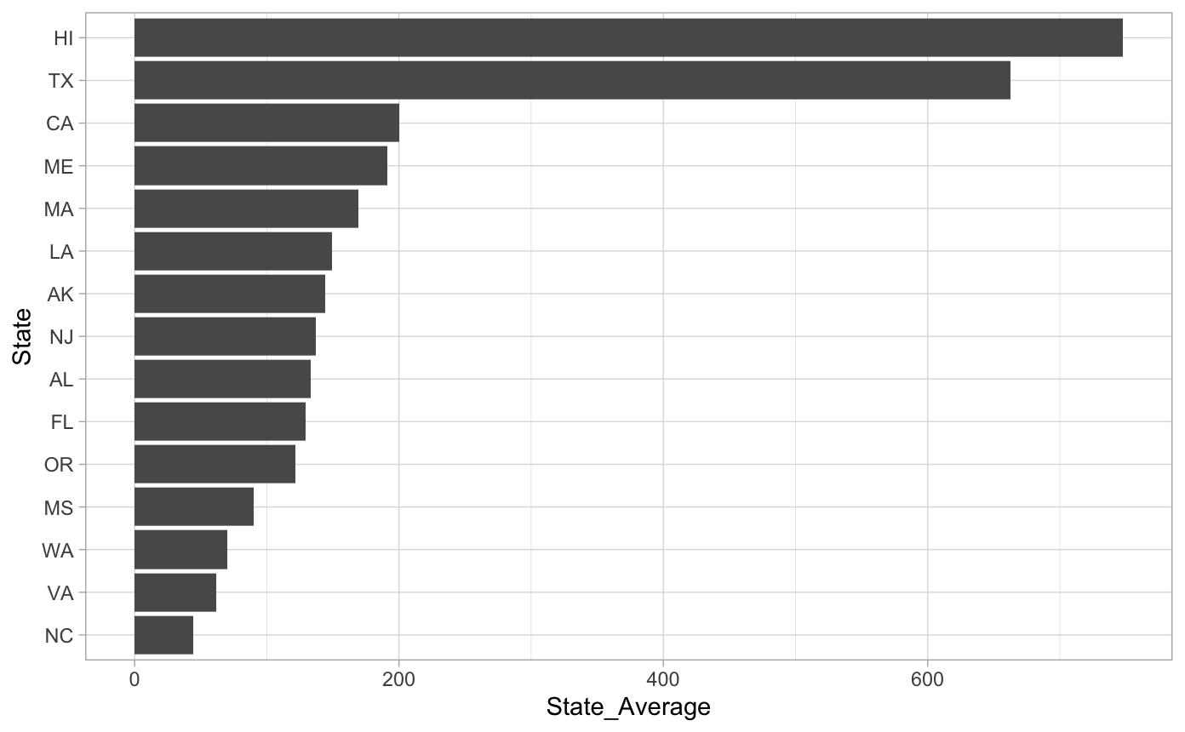
Average Garbage per Collection per State
Notes:
Talk through the challenges here on the different data Wrangling that we had to do

Slide 18
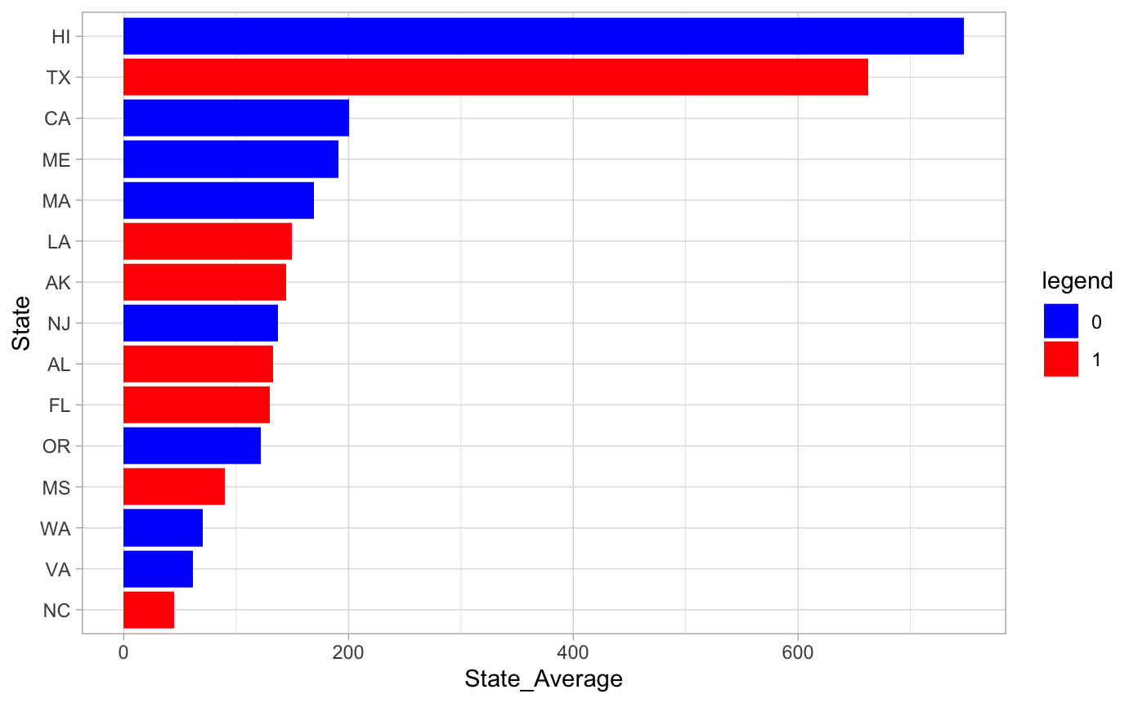
Assigning Political Affiliation
Notes:
Talk through the challenges here on the different data Wrangling that we had to do

Slide 19
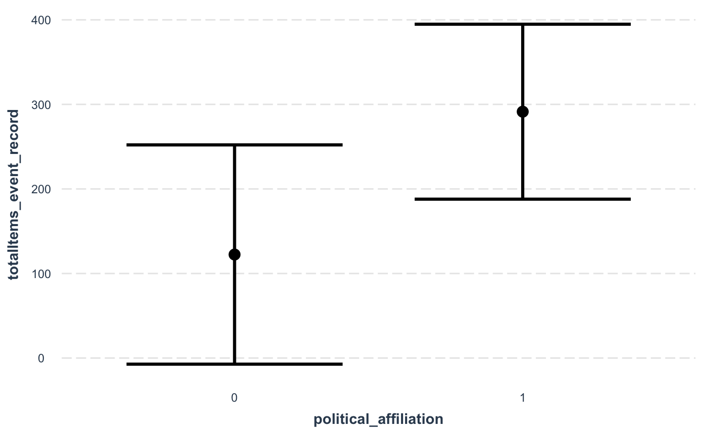
Effect of Political Affiliation on Garbage Collected
Notes:
Talk through the challenges here on the different data Wrangling that we had to do

Slide 20
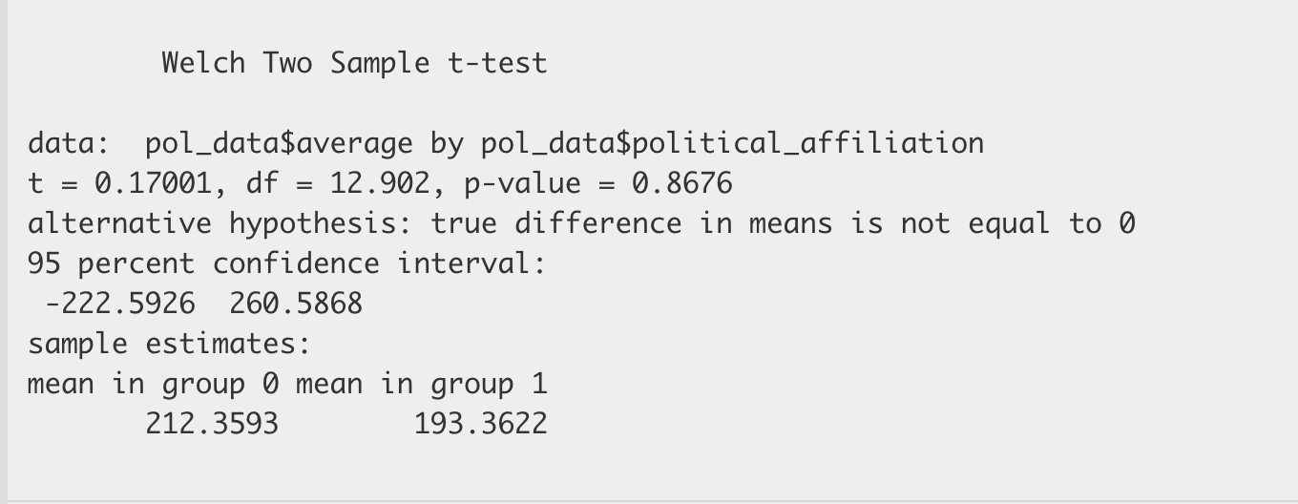
Hypothesis Test on Political Affiliation
Notes:
Talk through the challenges here on the different data Wrangling that we had to do

Slide 21
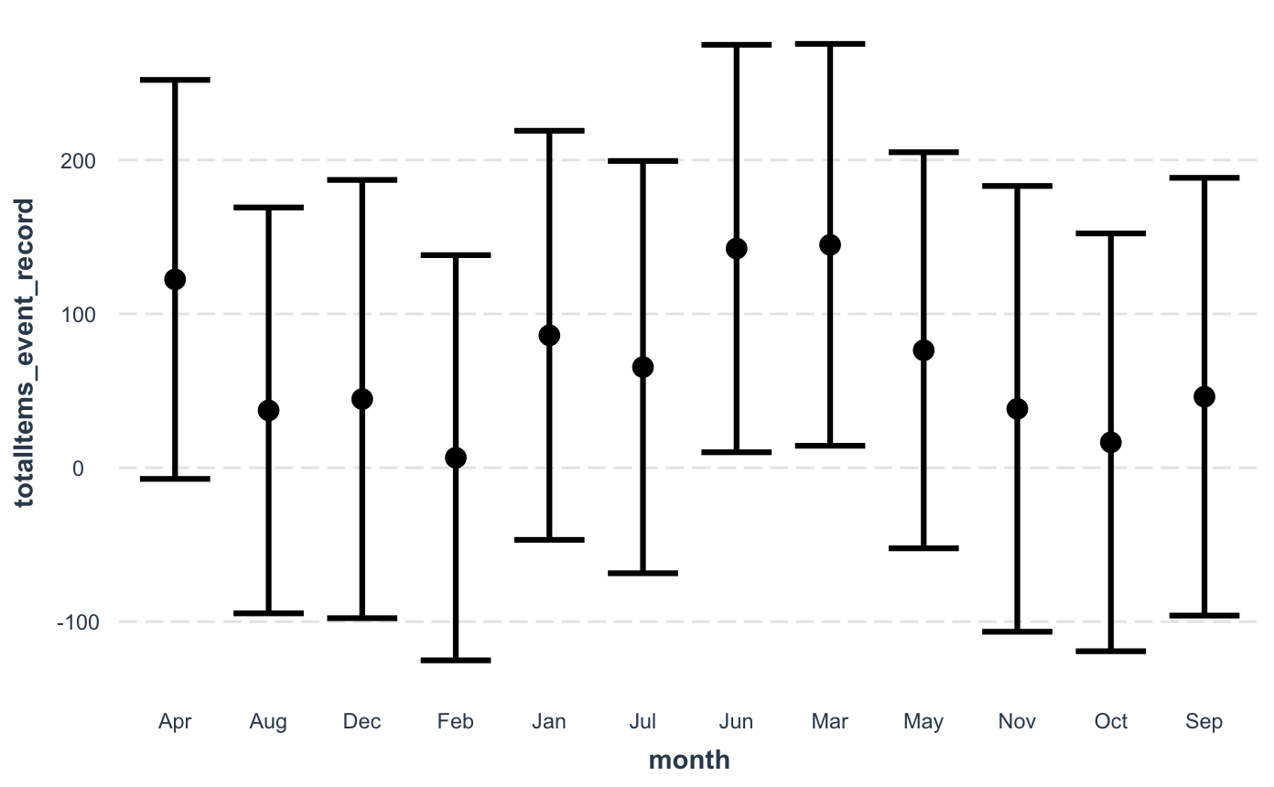
Effect of Month on Garbage Collected
Notes:
Talk about how winter did not have a large effect, but highest state was June and lowest was February

Slide 22
Percent of Plastic per State
Plastic is largest material found in coastline debris
Identifying which areas have a lot of plastic can lead to legislative action
No plastic straws in certain areas, etc.
Tried to create bar chart visualization
Unsuccessful since most rows did not contain appropriate classification of garbage collected
Saw 100% of plastic in a lot of cases, so not meaningful to compare
Notes:
Talk through the challenges here on the different data Wrangling that we had to do

Slide 23
Modeling and Model Results

Slide 24
Base Model
Y: total number of items collected on beach
X_{i}: (latitude, longitude, minute of day, county population, political affiliation, total area of the beach, land rank)
Correlation plot showed little correlation between other features
Linear model for high explanatory power
Notes:
Talk through the challenges here on the different data Wrangling that we had to do

Slide 25
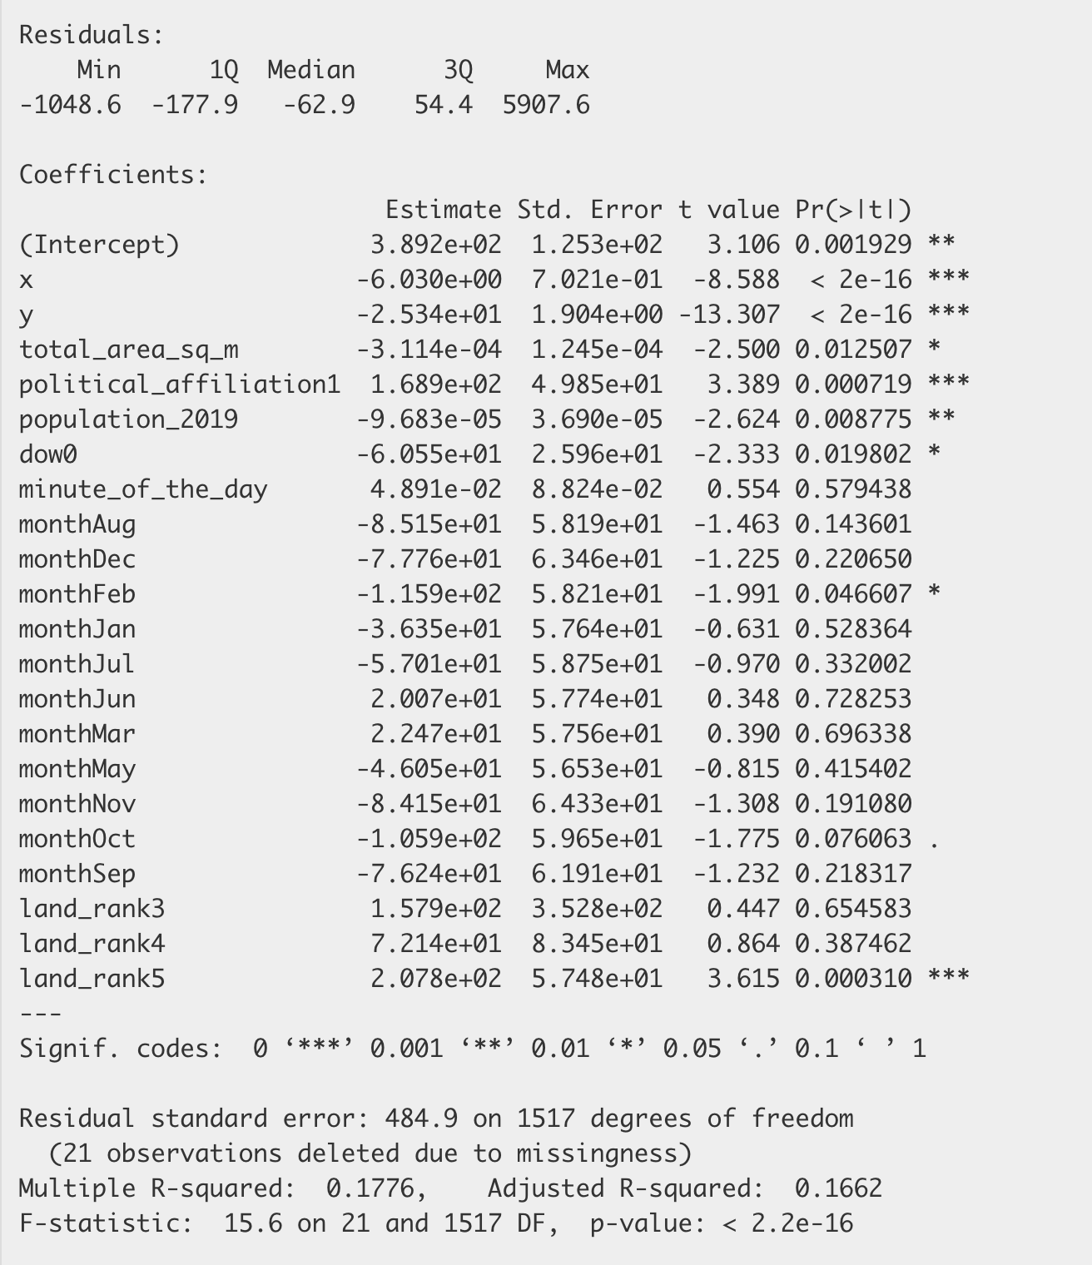
Base Model Results
Notes:
Talk through the challenges here on the different data Wrangling that we had to do

Slide 26
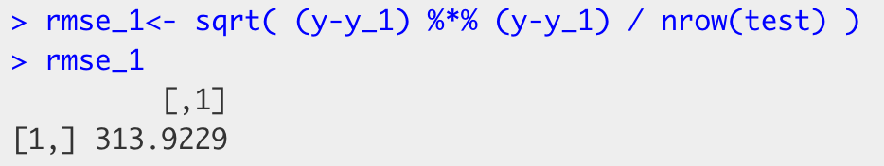
Base Model Results
Notes:
Talk through the challenges here on the different data Wrangling that we had to do

Slide 27
Transformed Model
Y: 1 / total number of items collected on beach
X_{i}: (latitude, longitude, minute of day, county population, political affiliation, total area of the beach, land rank)
Correlation plot showed little correlation between other features
Linear model for high explanatory power
Notes:
Talk through the challenges here on the different data Wrangling that we had to do

Slide 28
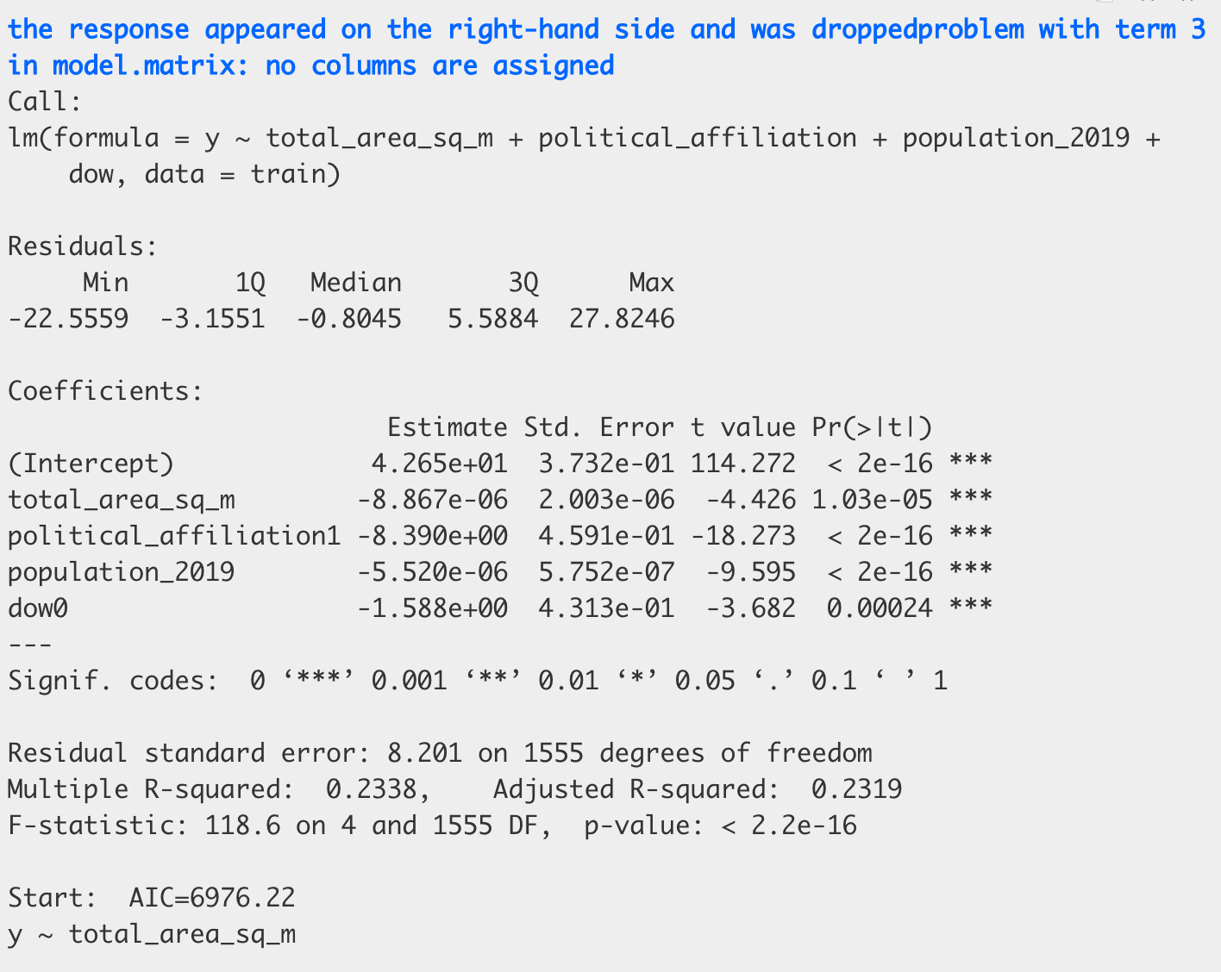
Transformed Model Results
Notes:
Talk through the challenges here on the different data Wrangling that we had to do

Slide 29
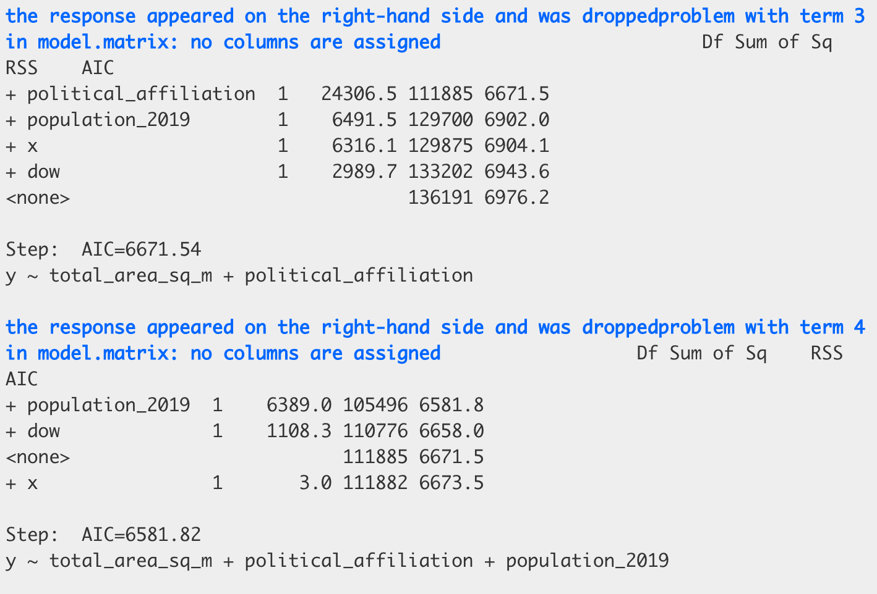
Transformed Model Results
Notes:
Talk through the challenges here on the different data Wrangling that we had to do

Slide 30
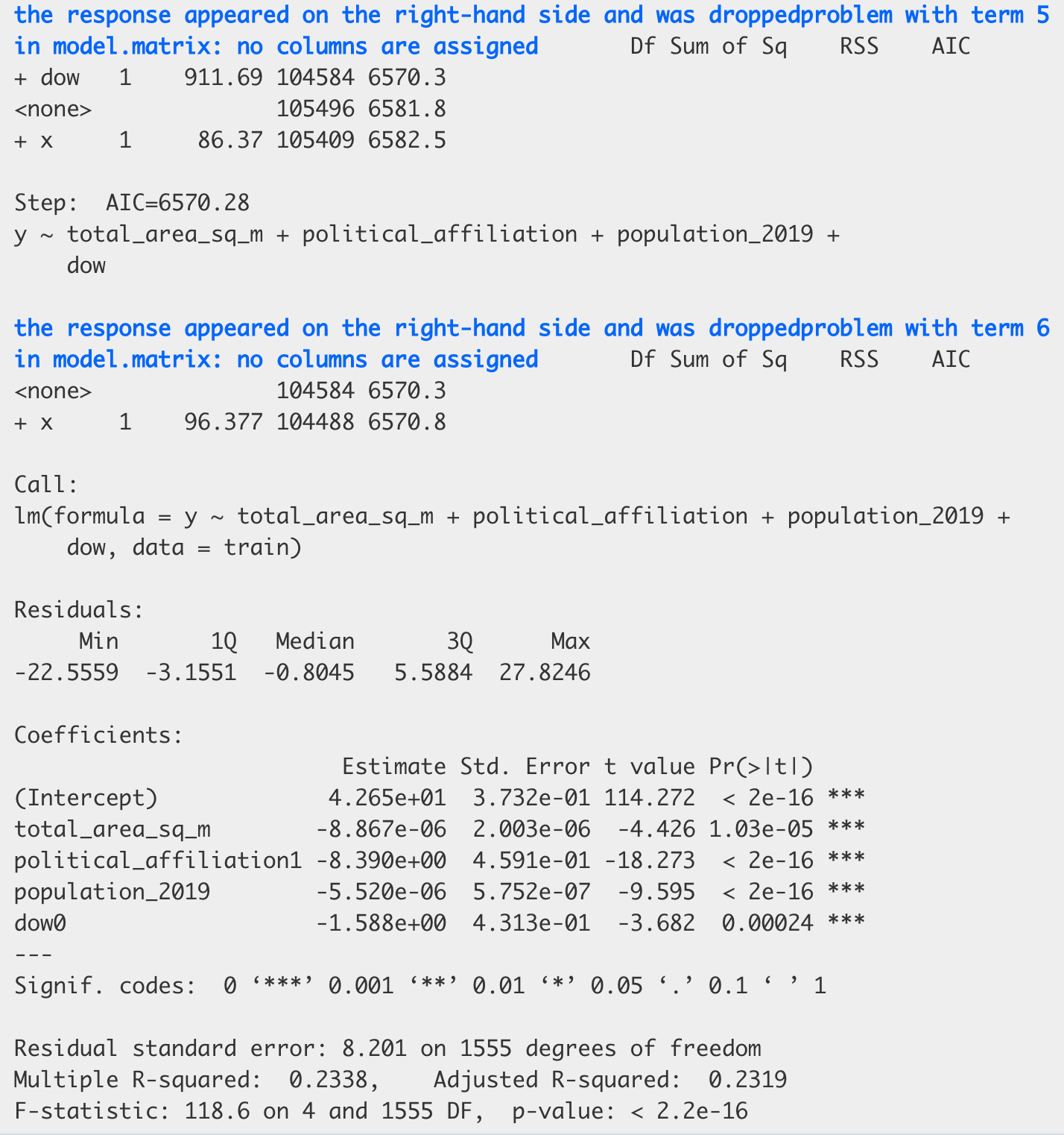
Transformed Model Results
Notes:
Talk through the challenges here on the different data Wrangling that we had to do

Slide 31
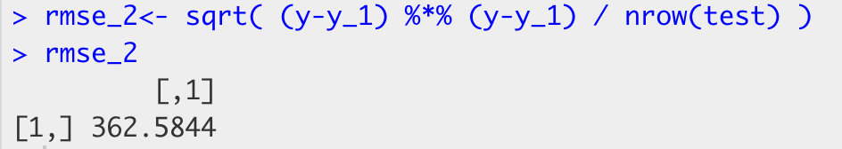
Transformed Model Results
Notes:
Talk through the challenges here on the different data Wrangling that we had to do

Slide 32
Model Diagnosis

Slide 33
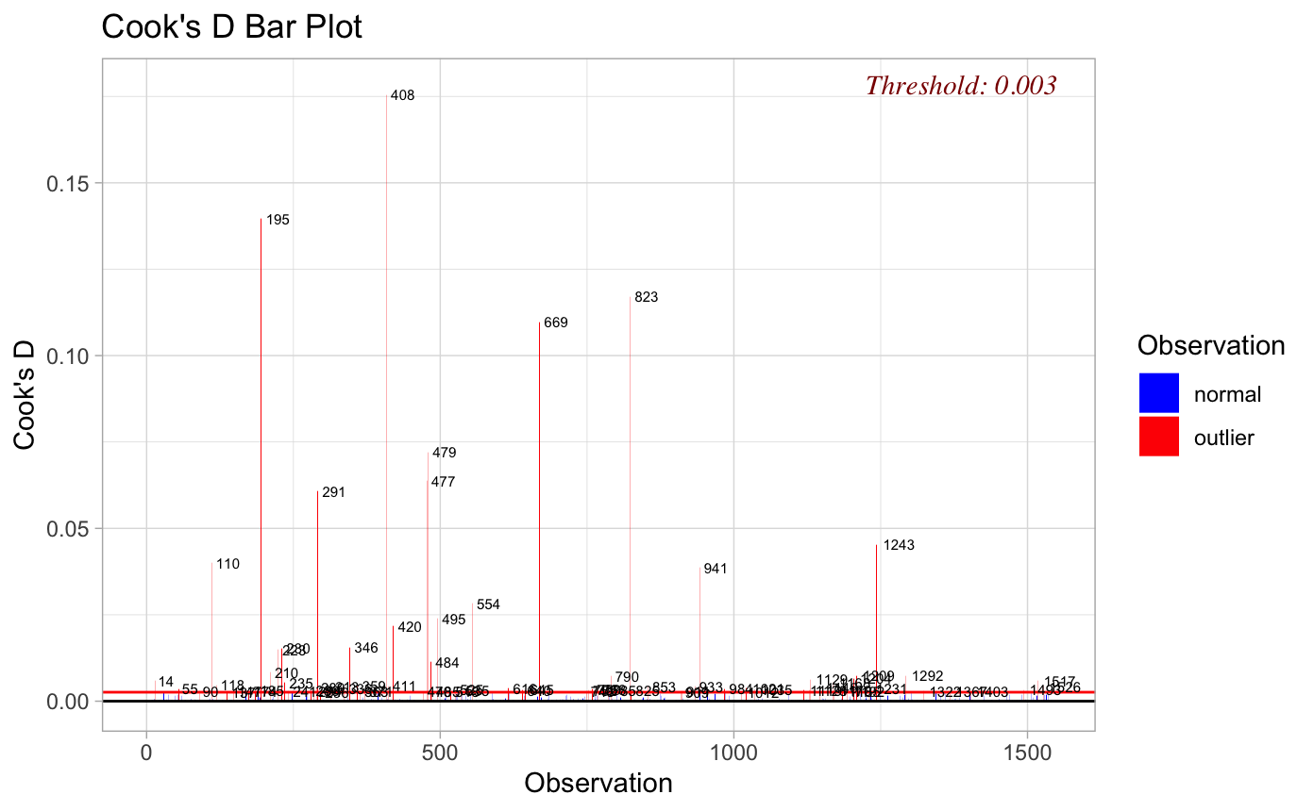
Base Model Cook’s Distance
Notes:
Talk through the challenges here on the different data Wrangling that we had to do

Slide 34
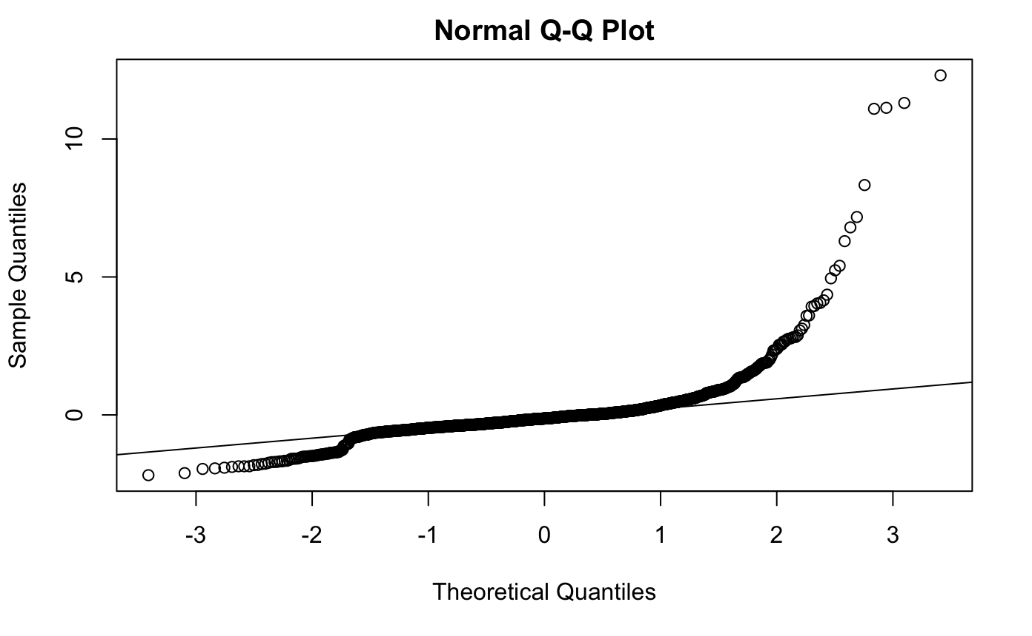
Base Model QQ Plot
Notes:
Talk through the challenges here on the different data Wrangling that we had to do

Slide 35
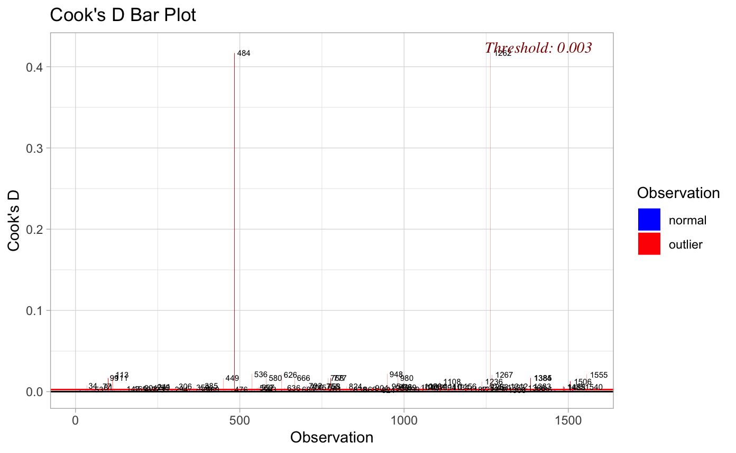
Transformed Model Cook’s Distance
Notes:
Talk through the challenges here on the different data Wrangling that we had to do

Slide 36
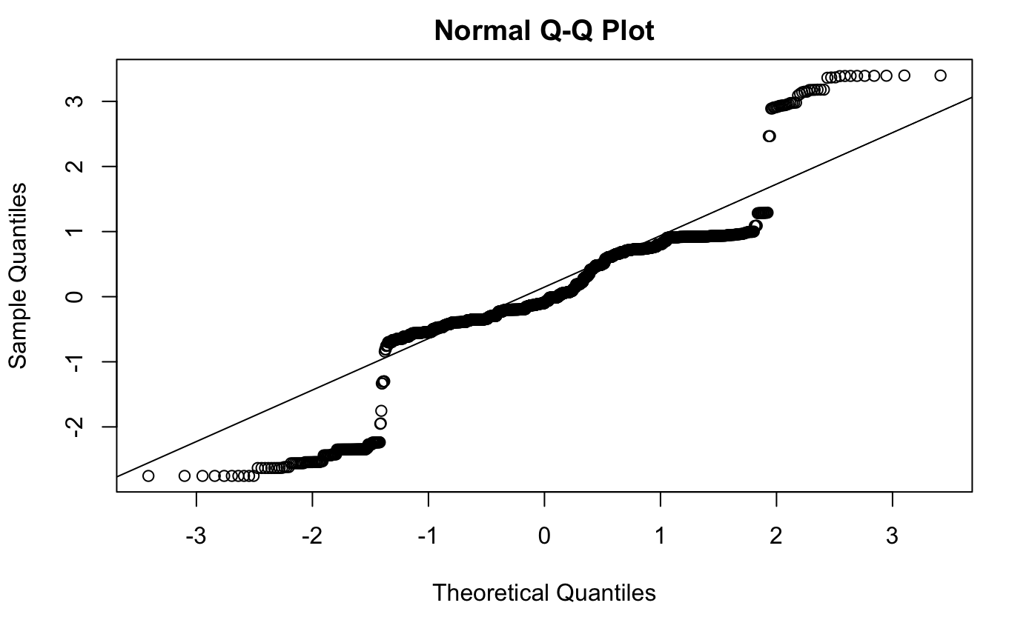
Transformed Model QQ Plot
Notes:
Talk through the challenges here on the different data Wrangling that we had to do

Slide 37
Conclusion and Future Works

Slide 38
Overview
Created multiple variations of linear model to predict garbage on beach
With limited explanatory power, focused efforts on inferential data analysis and increasing model accuracy
Created multiple visualizations during EDA to show relationships, or lack of relationships, between different variables
Did not create model for estimating labor required
Without large explanatory power, a labor estimation would prove to be useless and misleading
Notes:
Talk through the challenges here on the different data Wrangling that we had to do

Slide 39
Challenges Deep-Dive
Challenge 1
Challenge 2
Challenge 3
Lack of Explanatory Data
Model evaluations statistics show model does not explain a lot of variance in the data
Tried to increase model accuracy but still need more data
Sparsity of U.S. Data
With only 2,000 rows of data from specific regions, saw a lot of outliers
Without other data sources available, tried to explain entries we did have
Missing Features for Sub-Goals
Most of our sub-goals tried to show relationship with variables not in dataset
Had to manually find more data and merge frames

Slide 40
Future Works
Create model with global data to reduce sparsity of data
With 55,000 rows, may be able to create more accurate model
Obtain more external data and create new features
Data on holidays or festivals celebrated in same county as beach may be a good predictor of more people going to beach
Weather data
Garbage cans on beach
Type of plastics collected
Create estimation for number of volunteers needed to clean beach
Notes:
Talk through the challenges here on the different data Wrangling that we had to do

Slide 41
Thank you!

